Slide 1
Clothing - Shopping for clothes
Basic 4 Unit 11a

Slide 3
T-shirt

Slide 4
Jeans

Slide 5
Shorts

Slide 6
Dress

Slide 7
Skirt

Slide 8
Coat

Slide 9
Suit

Slide 10
Shirt

Slide 11
Tie

Slide 12
Vest

Slide 13
Jacket (Blazer)

Slide 14
Pants

Slide 15
Sweater

Slide 16
Sweat shirt

Slide 17
Sandals

Slide 18
Sneakers

Slide 19
Boots

Slide 20
High-Heeled shoes

Slide 21
Shoes

Slide 22
Socks

Slide 23
Scarf

Slide 24
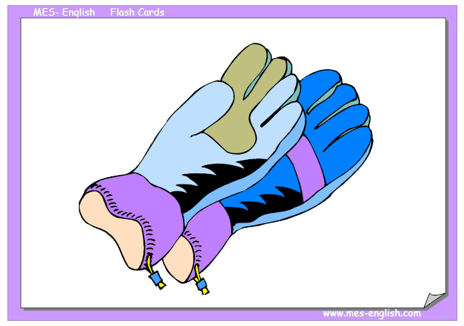
Gloves

Slide 25
Hat

